Slide 1

Sentiment and Emotion Analysis

Slide 2
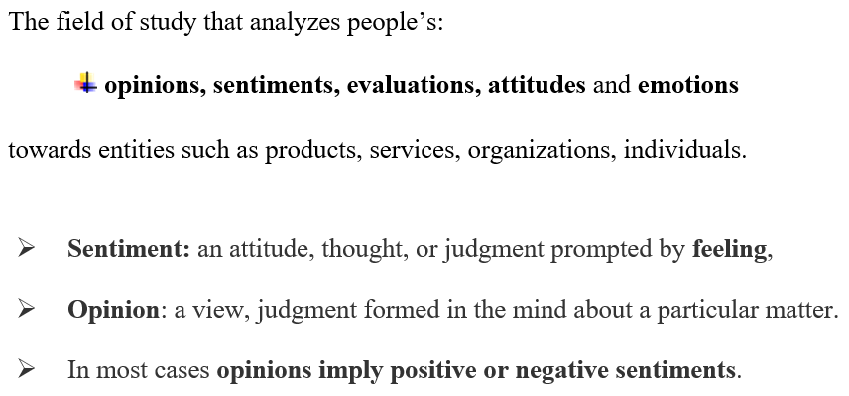
Sentiment analysis (opinion mining)

Slide 3
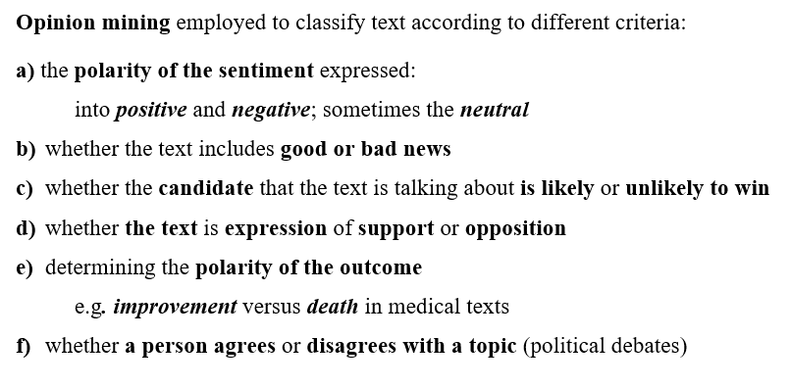

Slide 4
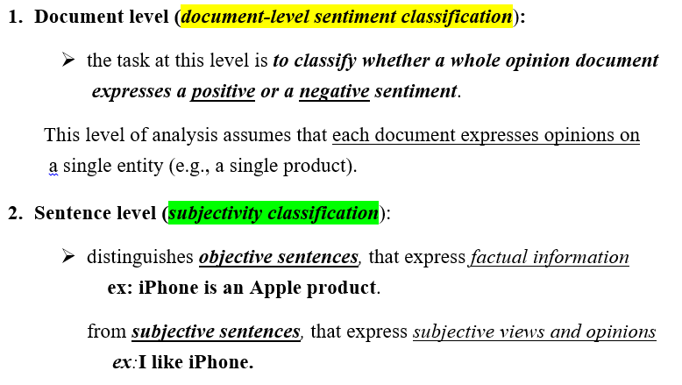
levels of sentiment analysis

Slide 5
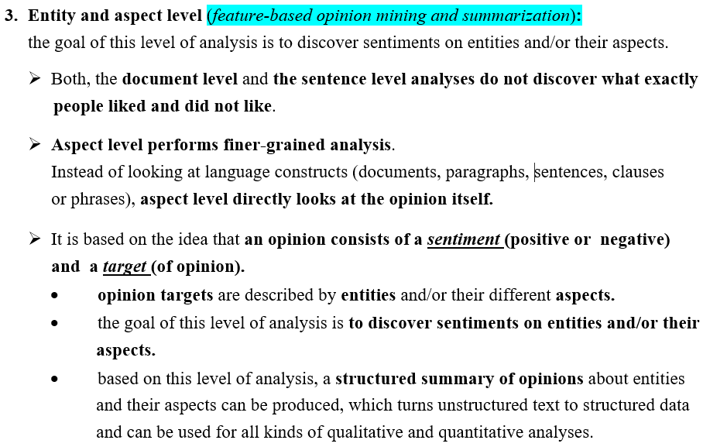
levels of sentiment analysis (contd.)

Slide 6
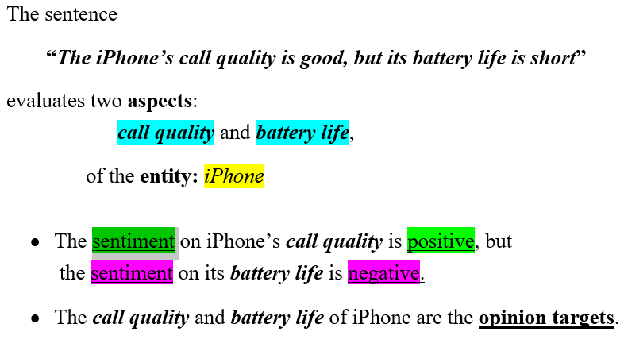
Example:

Slide 7
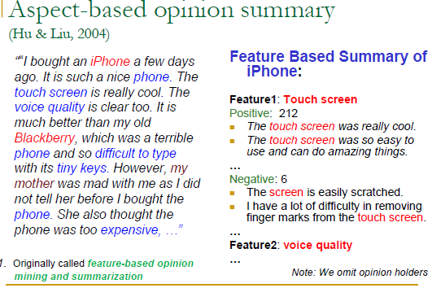

Slide 8
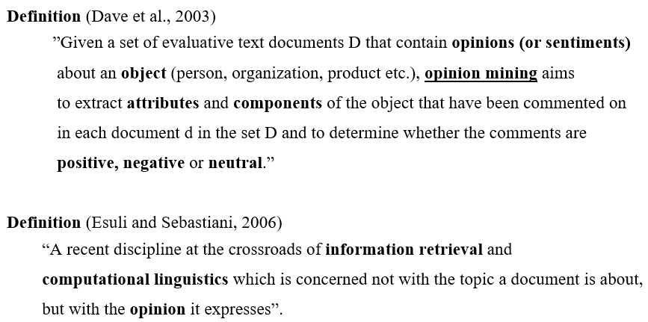
Opinion Mining

Slide 9
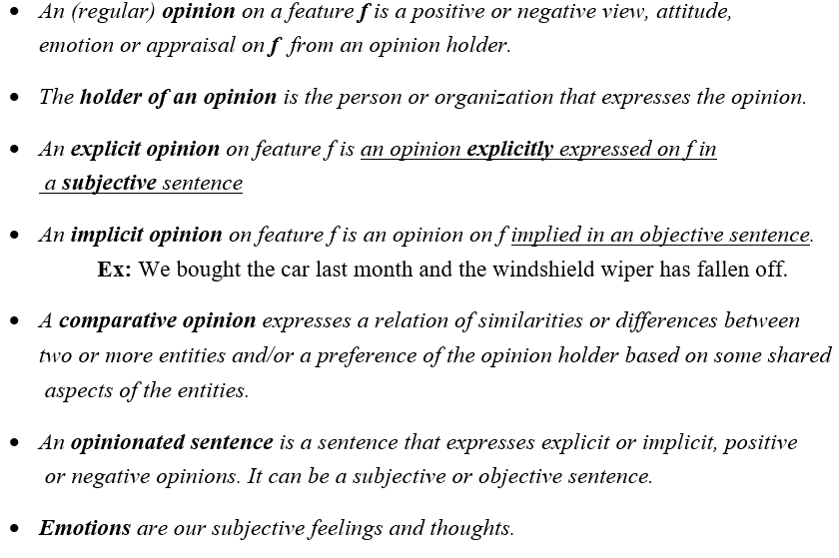
Definitions (Liu, 2010)

Slide 10
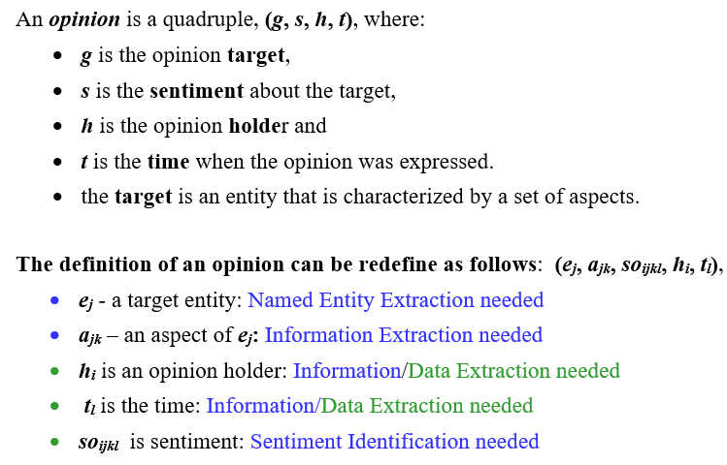
Opinion – formal definition

Slide 11
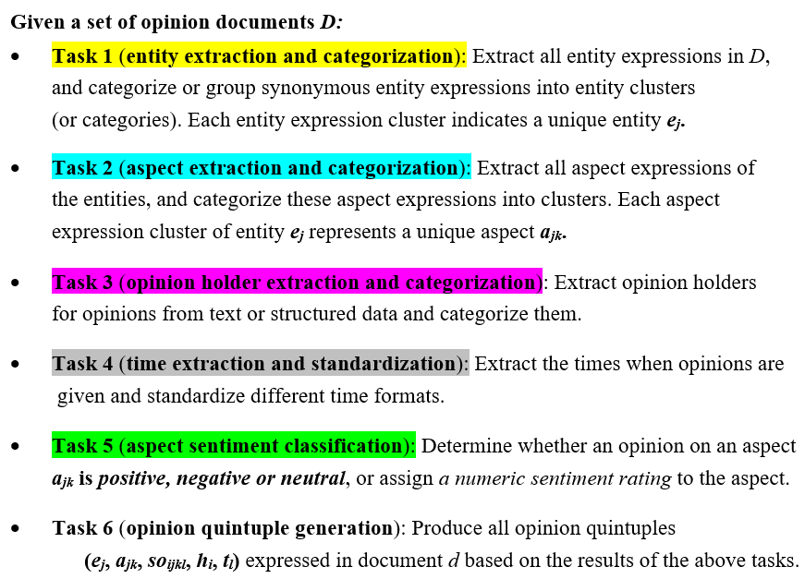
sentiment analysis (opinion mining) - 6 main tasks.

Slide 12
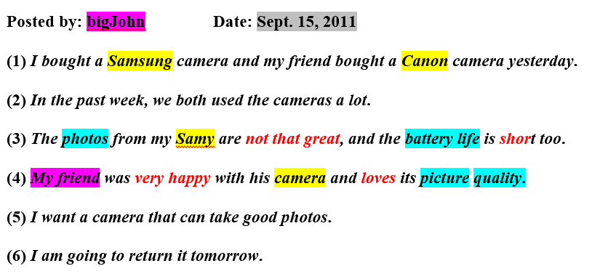
Example:

Slide 13
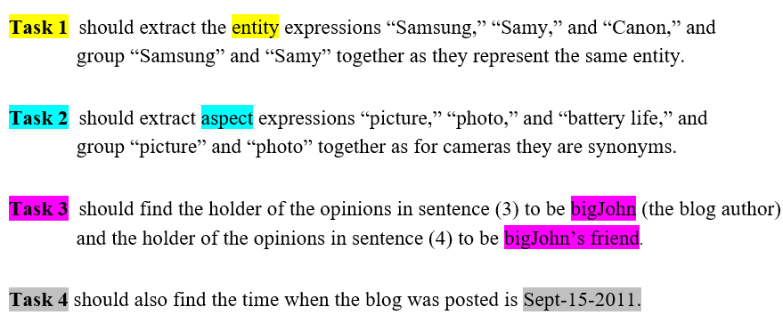
Solving Tasks:

Slide 14
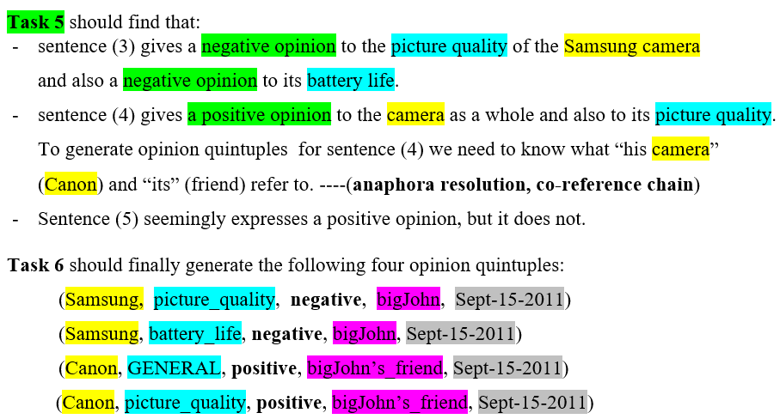
Solving Tasks:

Slide 15
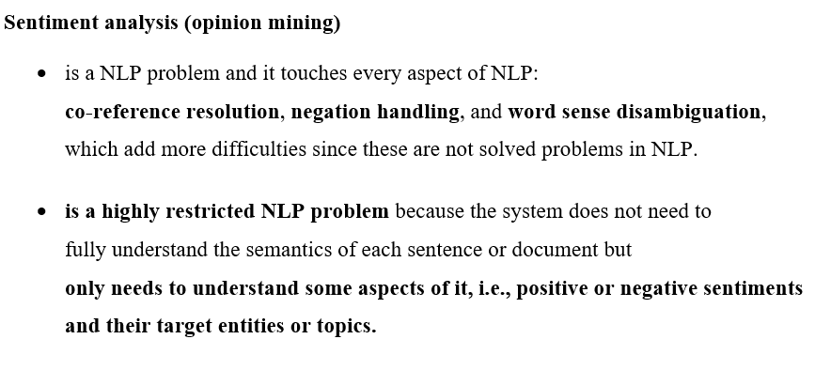

Slide 16
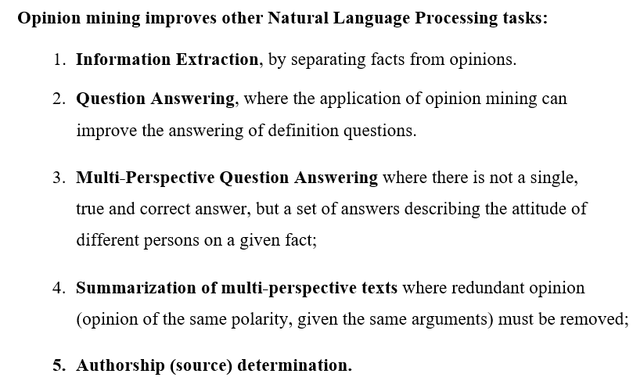

Slide 17
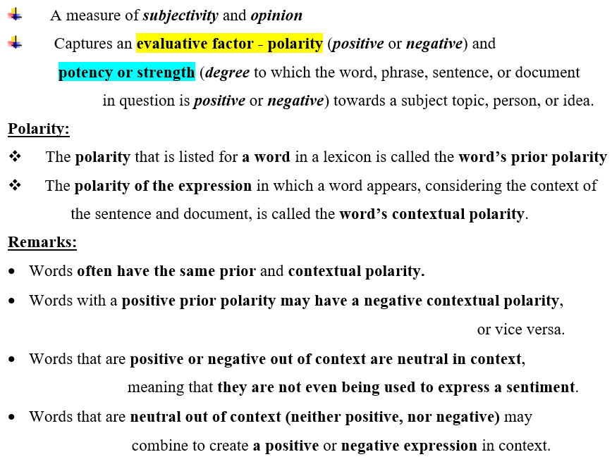
Semantic orientation (SO)

Slide 18
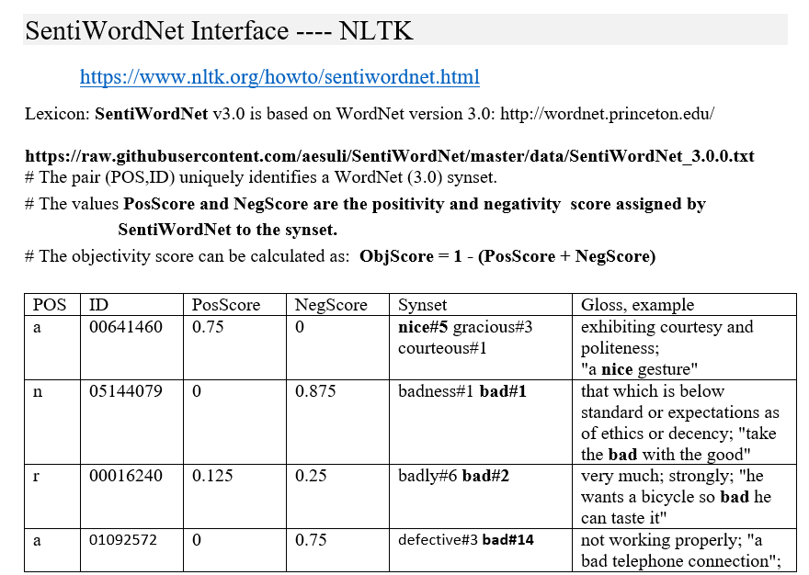
SentiWordNET

Slide 19

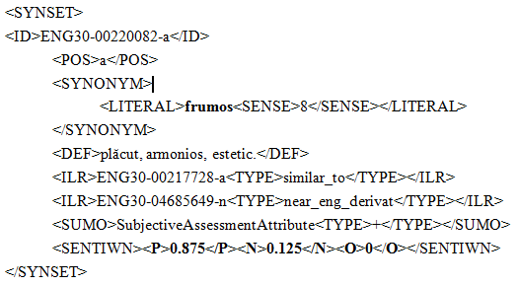
Polarity scores in RoWordNet

Slide 20
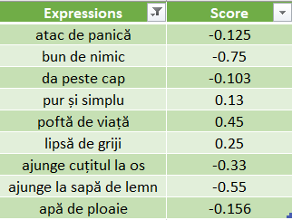
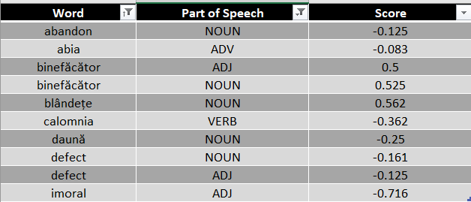
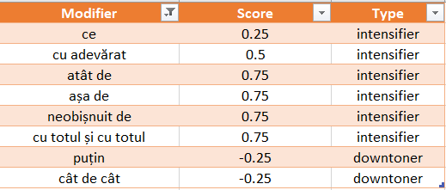
Romanian Opinion Lexicon

Slide 21
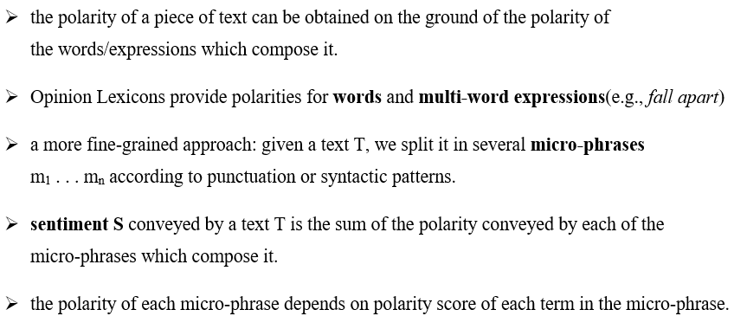
Lexicon-based approach for sentiment classification

Slide 22
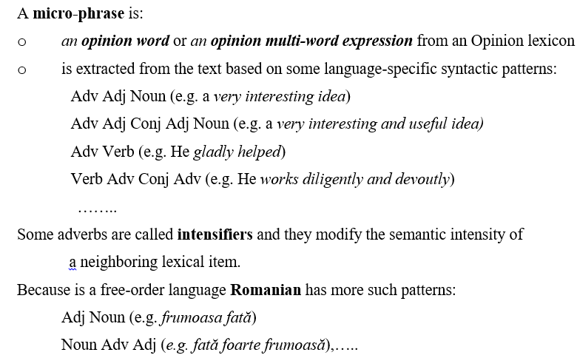
Lexicon-based approach for sentiment classification

Slide 23
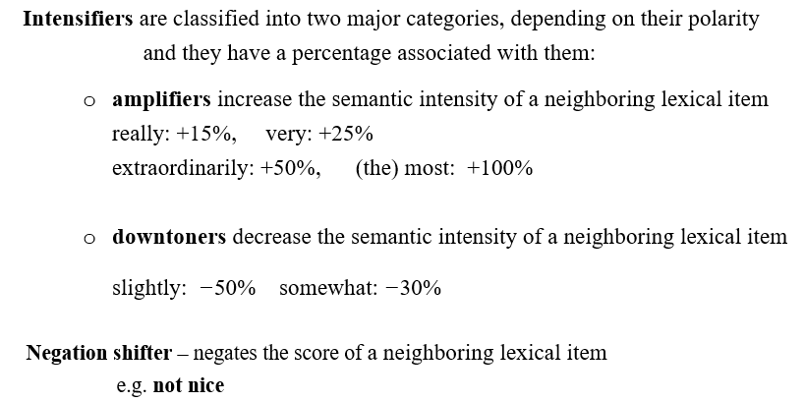
Lexicon-based approach for sentiment classification

Slide 24
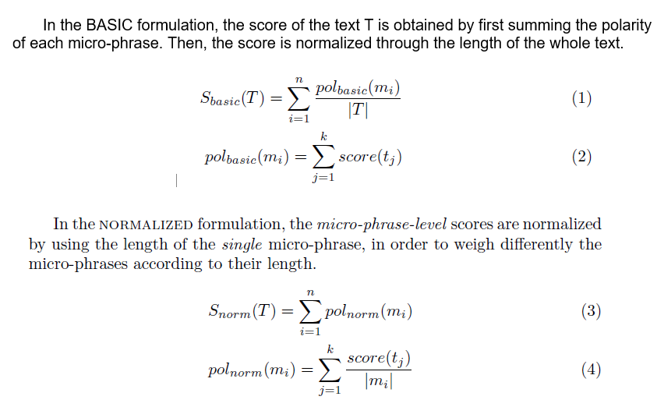
4 approaches to calculating the polarity score of a text

Slide 25
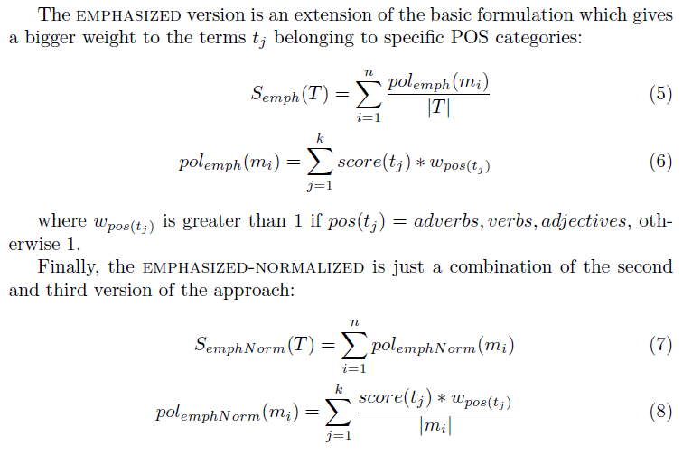
4 approaches to calculating the polarity score of a text

Slide 26
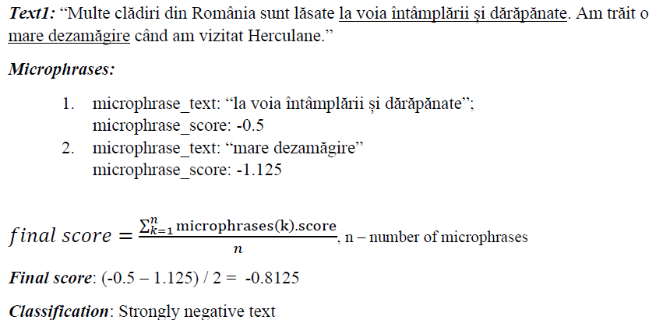
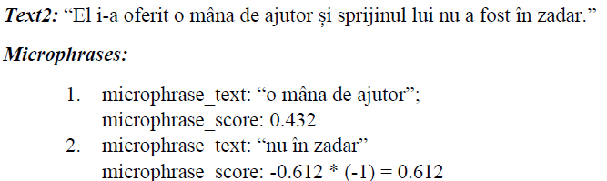
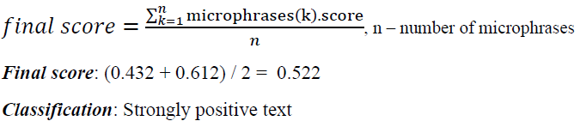
Examples:

Slide 27
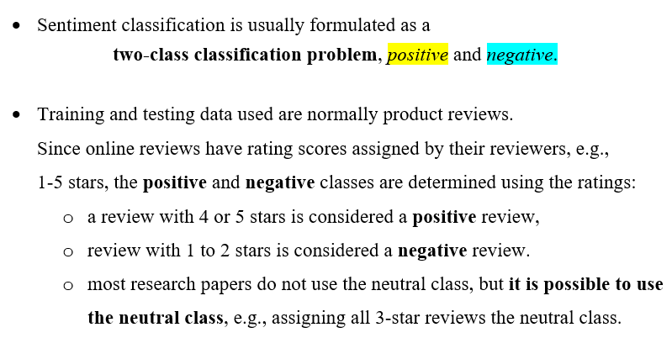
Sentiment Classification Using Supervised Learning

Slide 28
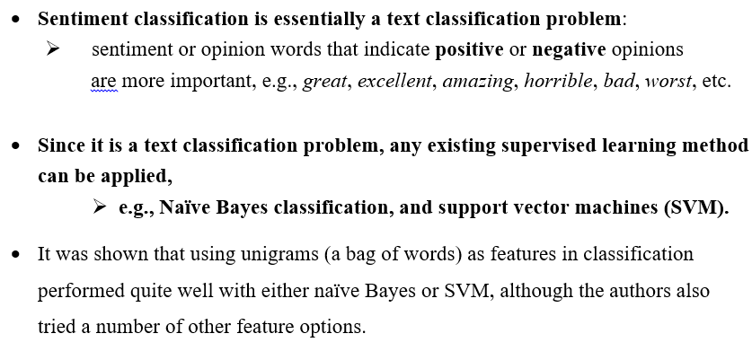

Slide 29
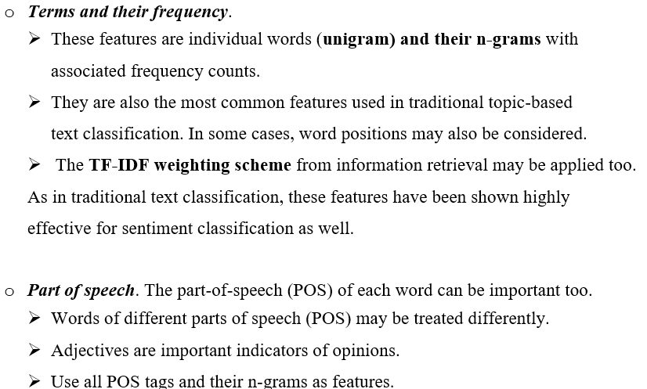
features used in classification:

Slide 30
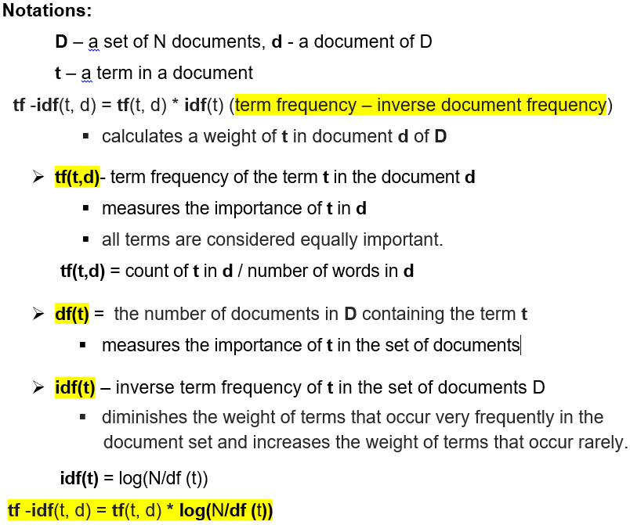
TF-IDF Weighting Scheme

Slide 31
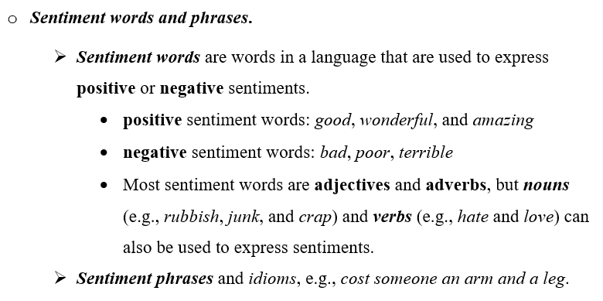
features used in classification:

Slide 32
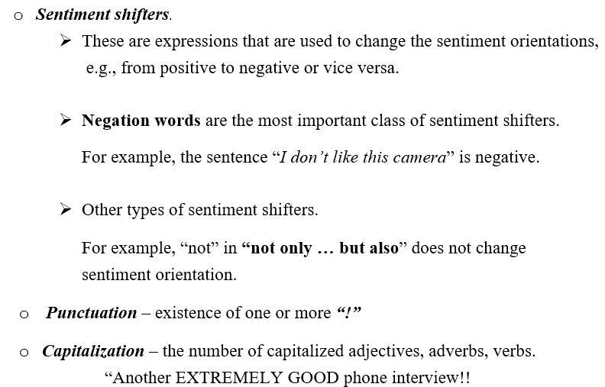
features used in classification

Slide 33
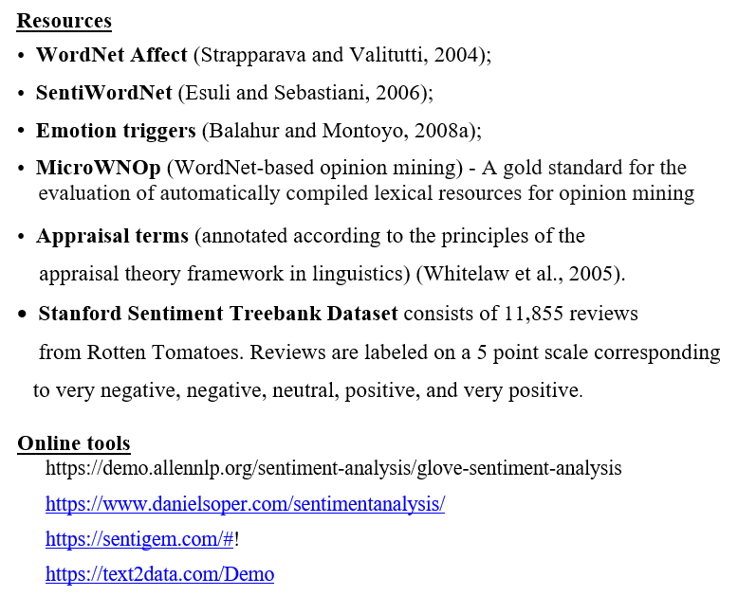

Slide 34
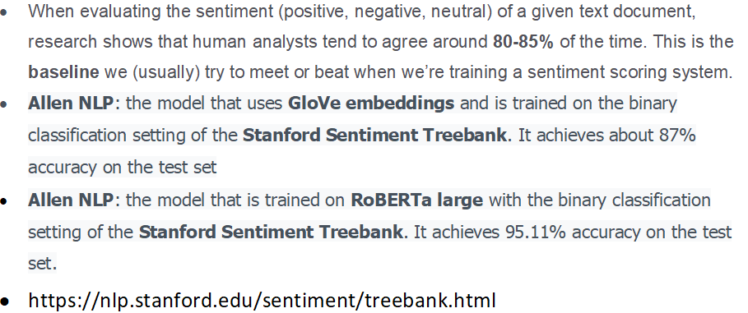
Performance in Sentiment Analysis

Slide 35
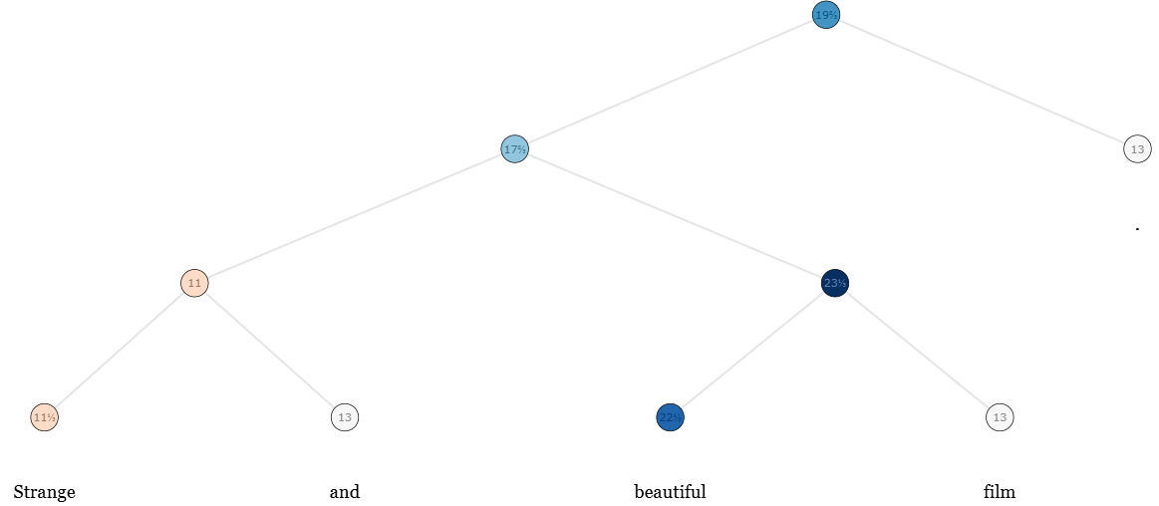
Strange and beautiful film.
https://nlp.stanford.edu/sentiment/treebank

Slide 36
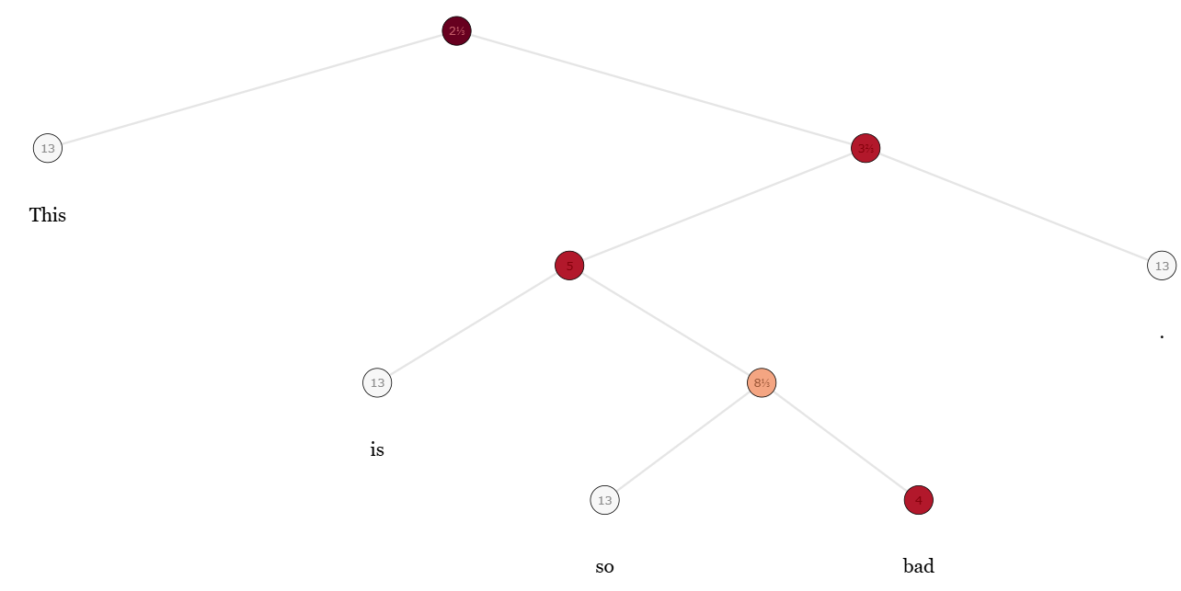
This is so bad.
https://nlp.stanford.edu/sentiment/treebank

Slide 37
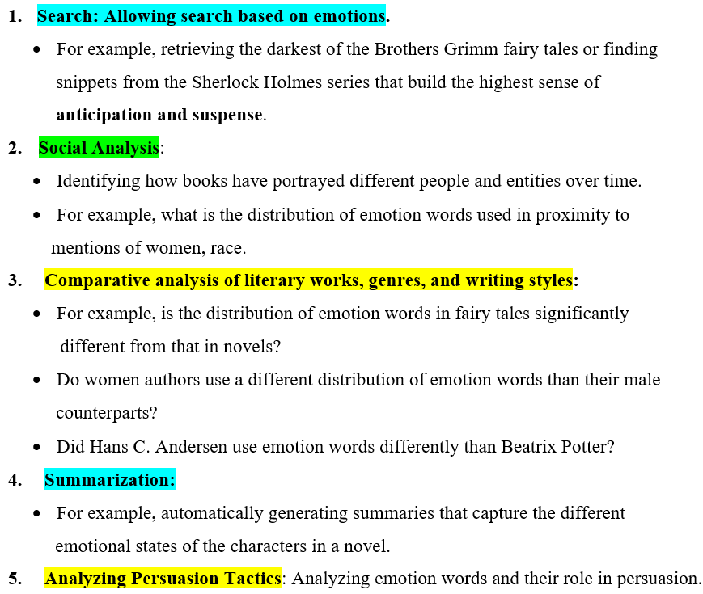
Emotion analysis - purposes

Slide 38
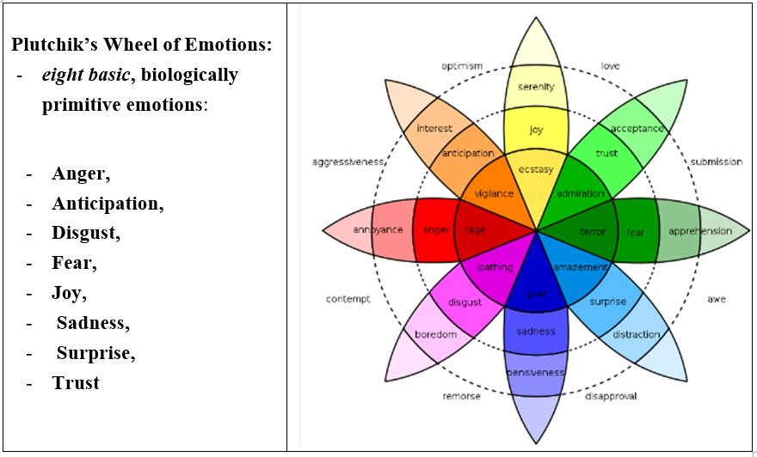
Theory of emotion Plutchik MODEL – A categorical model

Slide 39
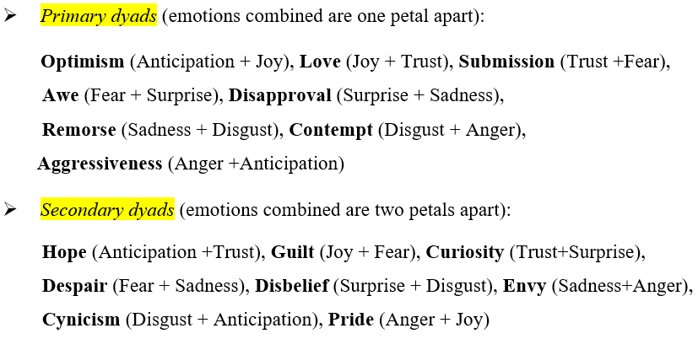
Derived emotions

Slide 40
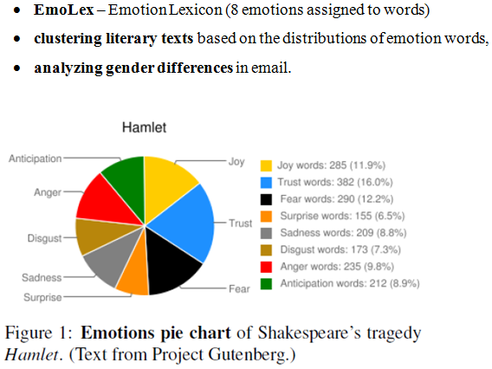
Emotion analysis

Slide 41
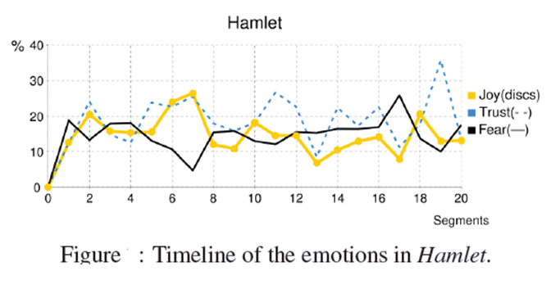

Slide 42
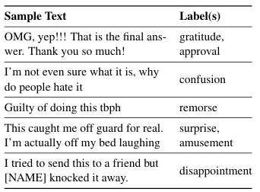
GoEmotions dataset
Contains 58k carefully curated Reddit comments labeled for 27
emotion categories or Neutral.
Emotion categories:
admiration, amusement, anger, annoyance, approval,
caring, confusion, curiosity,
desire, disappointment, disapproval, disgust,
embarrassment, excitement,
fear, gratitude, grief,
joy, love, nervousness, optimism,
pride, realization,
relief, remorse, sadness, surprise.

Slide 43
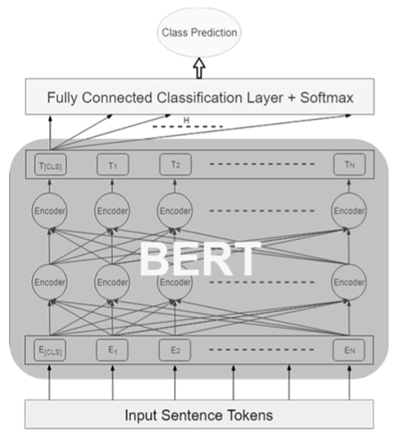
Fine-tuning BERT for sentiment or emotion classification
Sentiment classes:
positive, negative, neutral
Emotion classes:
happiness, anger, sadness, fear,…

Slide 44
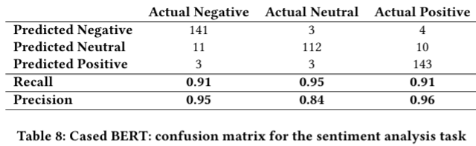
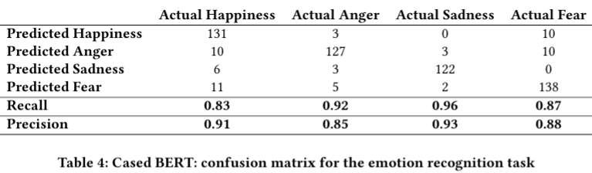
Evaluation results
Twitter sentiment dataset
Tweet EmotionIntensity dataset
https://saifmohammad.com/WebPages/TweetEmotionIntensity-dataviz.html

Slide 45
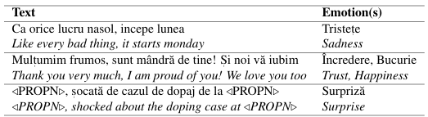
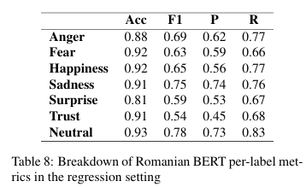

RED - Romanian Emotions Datasets v2
The second version of the Romanian Emotions Dataset (RED) containing 5449 tweets annotated in a multi-label fashion with the following
7 emotions: Anger (Furie), Fear (Frică), Joy (Bucurie), Sadness Tristețe), Surprise (Surpriză), Trust (Încredere) and Neutral (Neutru).
Ciobotaru, A., Constantinescu, M. V., Dinu, L. P., & Dumitrescu, S. (2022, June). RED v2: enhancing red dataset for multi-label emotion detection. In Proceedings of the thirteenth language resources and evaluation conference (pp. 1392-1399).

Slide 46

RoEmoLex - Lexicon de emoţii (~8000 entries)
https://www.cs.ubbcluj.ro/~ria/romanian-nlp-resources/

Slide 47

Emotion Embeddings built on CoRoLa Distant Supervision Dataset

Slide 48


